Slide 1

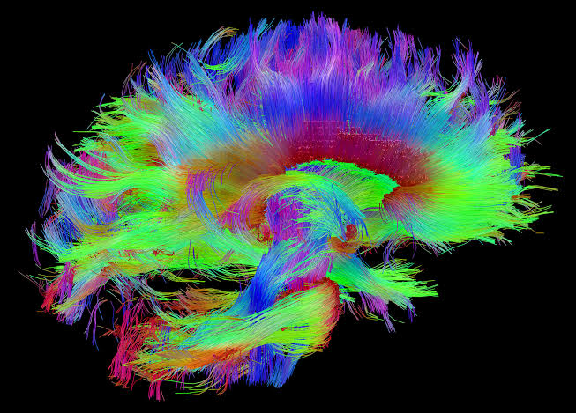
A 3D Printed Brain Computer Interface Neuroprosthesis
Samuel Parker
Completed Under the Supervision of
Dr Kaushik Mahata, Ph.D.

Slide 2
Notes:
The human brain is an immensely complicated entanglement of cells, each performing their own function to enable us to experience and interact with the world around us. Every thought you’ve had, the memories you’ve made throughout your life, every sensation you’ve felt, all your emotions, are all encoded as electrical signals. It is this passage of electricity that makes us human. For centuries, neuroscientists have been studying how the billions of cells in our brains interact in a global voyage of self discovery. Brain computer interfaces are a recent development that are built on the discoveries made in neuroscience. These devices have incredible potential to change the world, which I will discuss later, but for now, let’s take a closer look at how our brains work.

Slide 3
Na²⁺
K⁺
Notes:
The building block of our nervous system is the neuron. Your brain is made up of approximately 100 billion neurons! Neurons consist of dendritic branches, for listening to other neurons. These input signals are temporally integrated at the soma. Extending from the soma is the myelinated axon, which travels from the soma to the synaptic terminals, which connect to the dendrites of neighboring neurons. Neurons are surrounded by extracellular fluid and contain intracellular fluid. Each of these fluids contain different concentrations of ions, creating a concentration gradient across the cell membrane. At rest, the membrane potential is approximately -70mV. Excitatory neurotransmitter signals from other neurons arriving at the dendritic arbor temporarily opens ionic channels, slightly depolarizing the cell. In isolation, the passage of ions across the membrane will restore this slight positive change. However, when many signals occur in a short period, the cell will sufficiently depolarize to reach its threshold potential. Once this threshold potential is reached, a chain of events called an action potential occurs. Initially, voltage gated sodium channels open, allowing positive sodium ions to travel down their concentration gradient, into the cell. This generates a positive membrane potential. This positive membrane potential opens voltage gated potassium channels, which allows positive potassium ions to travel down their concentration gradient, out of the cell. The voltage gated sodium channels are now closed, so the efflux of potassium ions restores the neuron to its resting potential.

Slide 4
Notes:
By now, a voltage pulse has occurred, which conducts ionically down the axon and to the synaptic terminals, where it is passed to other neurons via the release of excitatory neurotransmitters.

Slide 5
Notes:
It is this repeated action potential that generates the spike trains that neurons use to communicate.

Slide 6
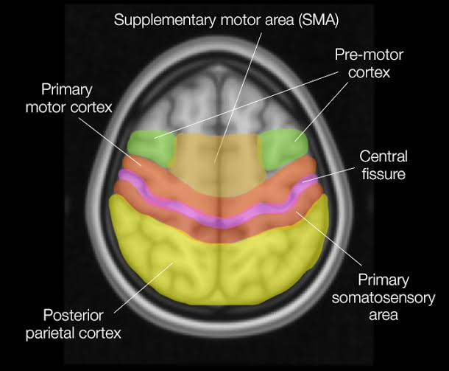
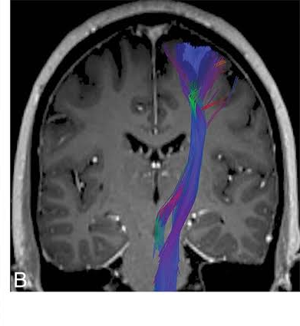
Notes:
The brain is systematically organized into regions of neurons with similar function. For example, these slides show the cortical regions responsible for voluntary skeletal movement, the pre-motor cortex, primary motor cortex and supplementary motor area. On the right you can see the corticospinal tract that makes up the internal capsule. This is the information superhighway connecting the motor cortical areas to the lower motor neurons in the spinal cord.

Slide 7
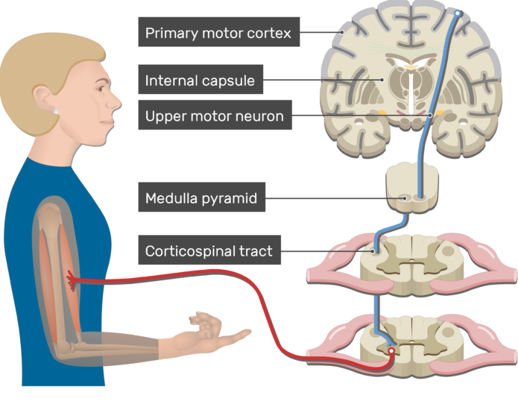
Breakdown in Signalling Path
Stroke
Spinal Cord Injury (SCI)
Degenerative Disease
Amputation

